Slide 1
India COVID Summary
April 16, 2021

Slide 2











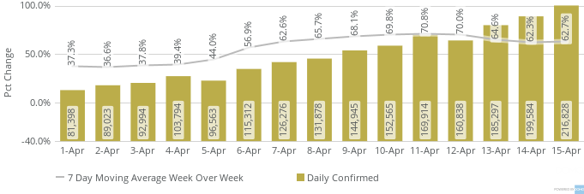
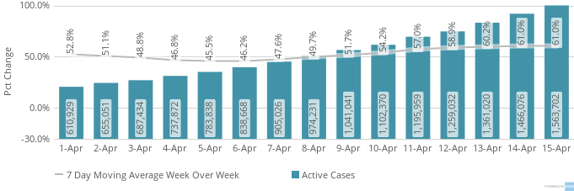
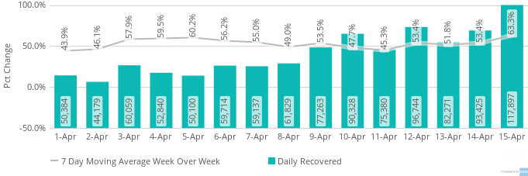
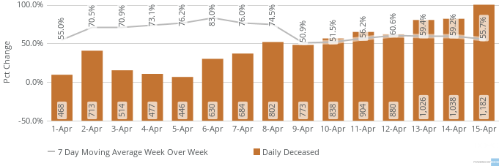
INDIA COVID Dashboard as of
April 15
Confirmed
Active
Recovered
Deceased
Tested
14.3M
1.6M
12.5M
174.3K
263.5M
216.8K
117.9K
1.2K
1.5M
Active Rate | Recovery Rate | Mortality Rate | Positivity Rate | Confirmed/100k | Tests/1M | Confirmed/1M
Confirmed
Active
Recovered
Deceased
*Data Source : https://www.covid19india.org/

Slide 3







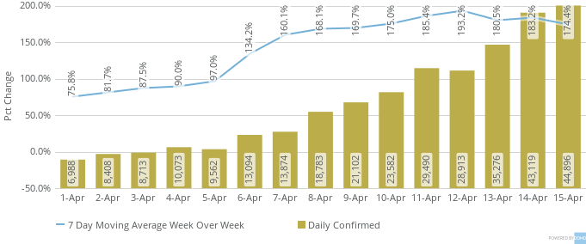
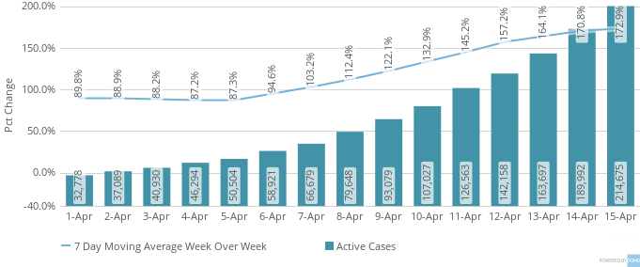
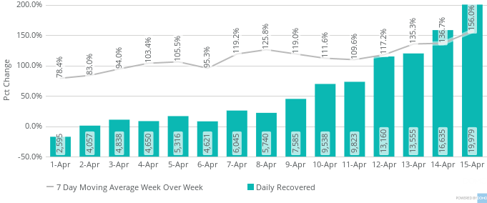
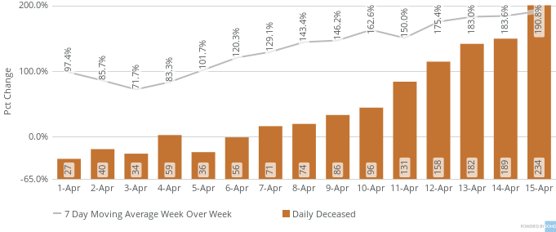
NCR – Week Over Week Changes in 7 Day Moving Average
Active Rate | Recovery Rate | Mortality Rate | Positivity Rate | Confirmed/100k | Tests/1M | Confirmed/1M
Confirmed
Active
Recovered
Deceased

Slide 4






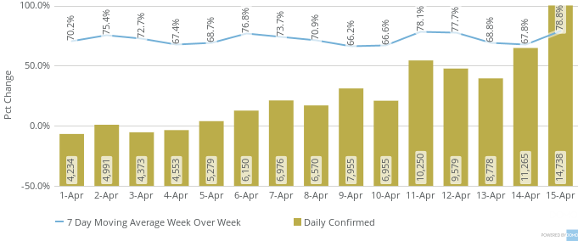
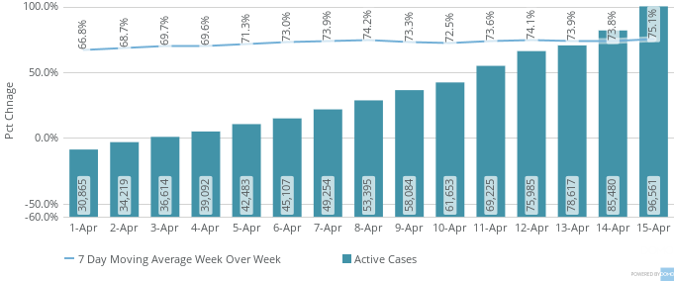
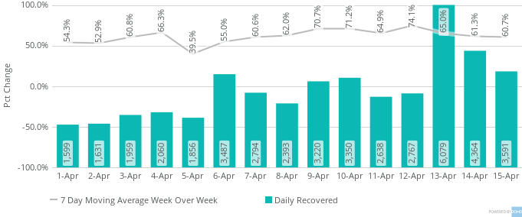
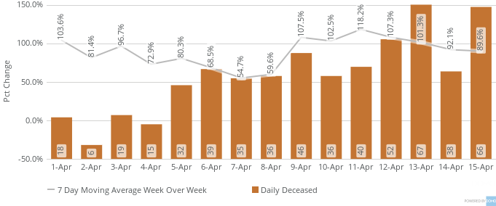
Karnataka – Week Over Week Changes in 7 Day Moving Average
Active Rate | Recovery Rate | Mortality Rate | Positivity Rate | Confirmed/100k | Tests/1M | Confirmed/1M
Confirmed
Active
Recovered
Deceased

Slide 5







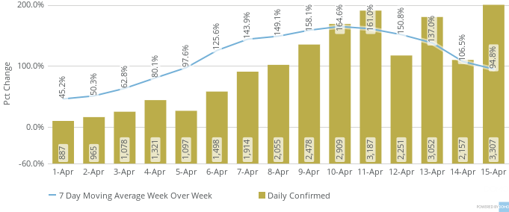
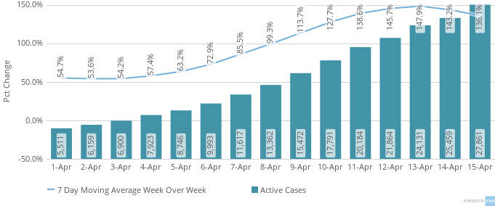
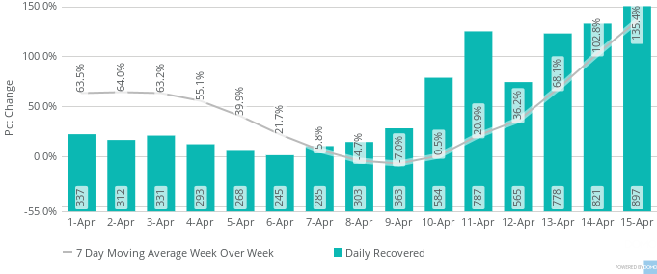
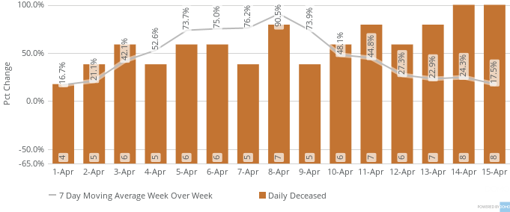
Telangana – Week Over Week Changes in 7 Day Moving Average
Active Rate | Recovery Rate | Mortality Rate | Positivity Rate | Confirmed/100k | Tests/1M | Confirmed/1M
Confirmed
Active
Recovered
Deceased

